Slide 1
Week 6 Consolidation Week
LM Data Structures, Algorithms, and Databases
(34141)
Dr Ahmad Ibrahim
a.ibrahim@bham.ac.uk
Feb 23, 2024
Contents based on lecture notes from Uday Reddy & Achim Jung

Slide 2

Topics by Week
Week | Date | Topic
1 | 15 Jan | Searching algorithms
2 | 22 Jan | Binary Search Tree
3 | 29 Jan | Balancing Trees – AVL Tree
4 | 5 Feb | Databases – Conceptual Design
5 | 14 Feb | Databases – Logical Design & Relational Algebra
6 | 19 Feb | Consolidation Week
7 | 26 Feb | Graph Algorithms
8 | 4 Mar | Sorting Algorithms
9 | 11 Mar | Hash tables
10 | 18 Mar | Databases – Normalization
 |  | Easter break and Eid break
11 | 22 Apr | Databases – Concurrency
12 | 29 Apr | Revision Week

Slide 3
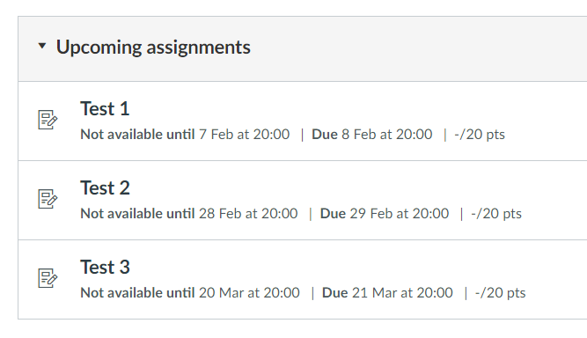
Assessments
Assessments (Test 1, Test 2, Test 3): 20%
Exam: 80%
Late Submission Policy:
Submissions between 8:00-8:30pm (Dubai Time) on 08 Feb incur a 10% penalty.
Zero marks for submissions after 8:30pm.
Wellbeing approved cases: 1 day extension only.
Week 4
Week 7
Week 10

Slide 4

Topics covered in Week 4
Handout 1 & 2
Introduction
Relational databases
Entity-relationship (ER) diagram /Modeling
Table design and creation, SQL
Weak entities
Hierarchies
Table design (schemas) Optimisation
SQL Commands + PostgreSQL

Slide 5
Topics covered in Week 5
Handout 3,4,5
Logical Design
Relational algebra
Filter relations - Select σ
Slice relations - Project π
Combine relations (Joins)
Decomposition / Functional dependency

Slide 6
Outline (This Week)
(Part 0) SQL statements
ex00.pdf
PostgreSQL
(Part 1) ER modelling & Logical design
ex01.pdf
(Part 3) Relational algebra
ex02.pdf

Slide 7

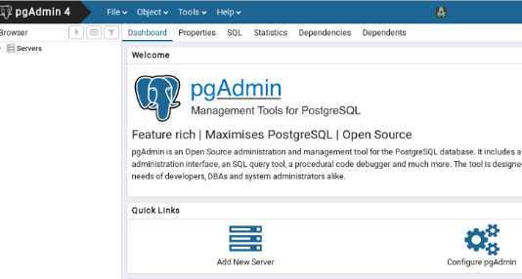
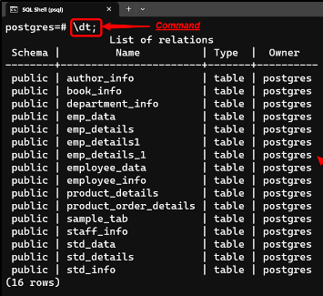
Free and open-source relational database management system
https://www.postgresql.org/download/

Slide 8
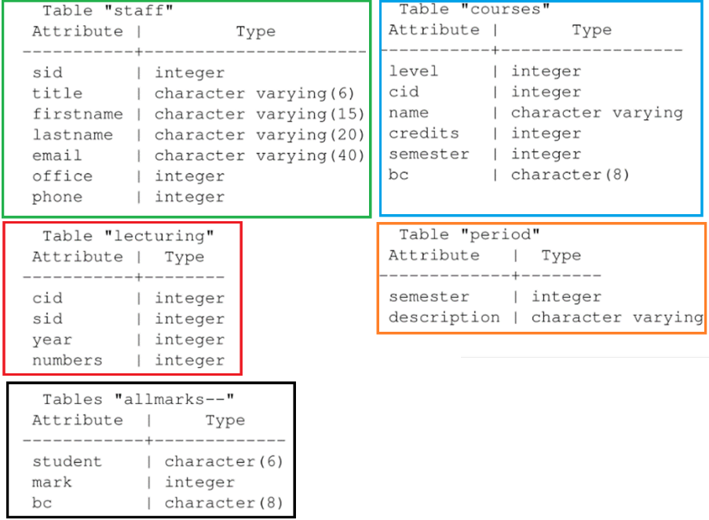
Fundamentals
Database

Slide 9
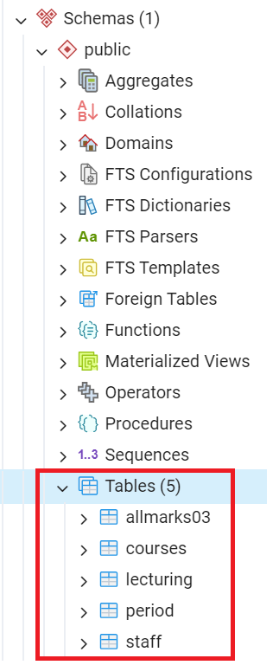
Fundamentals
Database
pgAdmin4
You need to download the file 'FundamentalsSchemaData.txt' from Canvas to create this ‘Fundamentals’ schema and data in your local PostgreSQL installation. Once completed, you will be able to solve ex00.pdf.

Slide 10
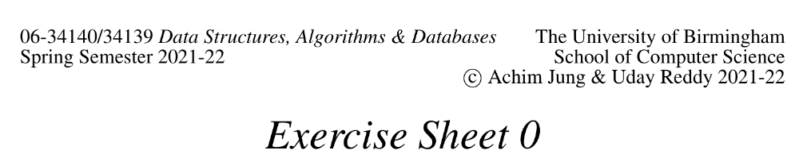

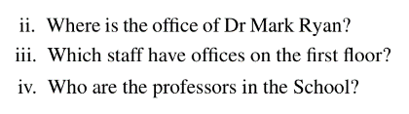

Slide 11
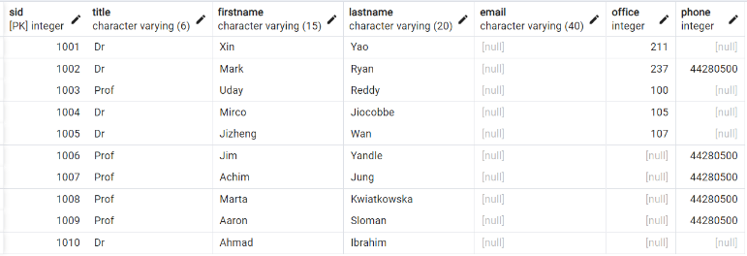
staff

Slide 12

staff

Slide 13

staff

Slide 14
staff

Slide 15
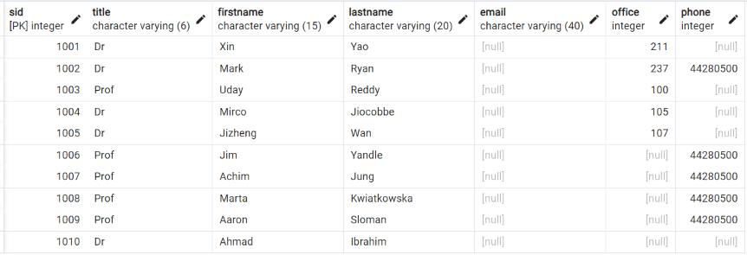
staff

Slide 16
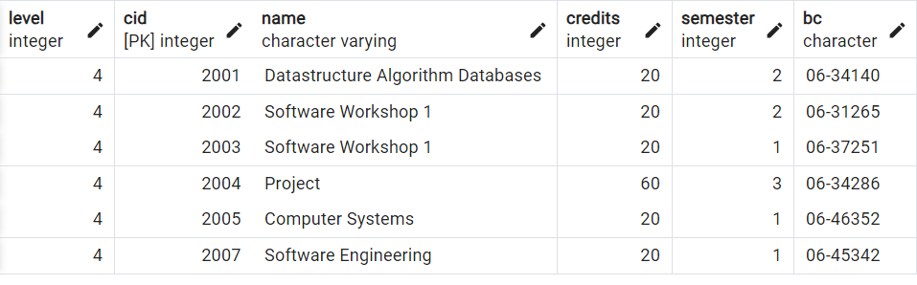
courses

Slide 17
staff

Slide 18
staff

Slide 19
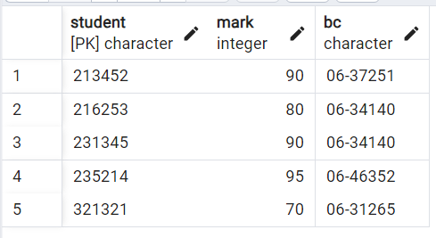
allmarks03

Slide 20
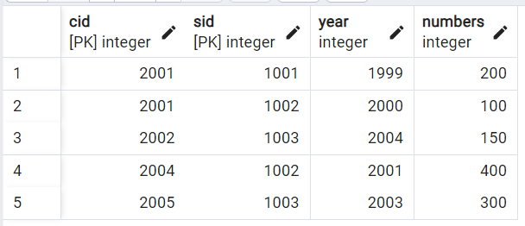
lecturing

Slide 21
lecturing

Slide 22
Outline (This Week)
(Part 0) SQL statements
ex00.pdf
PostgreSQL
(Part 1) ER modelling & Logical design
ex01.pdf
(Part 3) Relational algebra
ex02.pdf

Slide 23
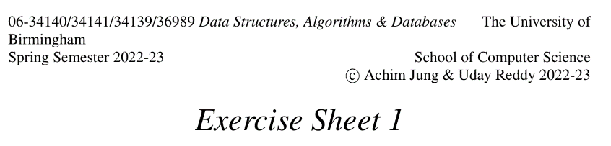
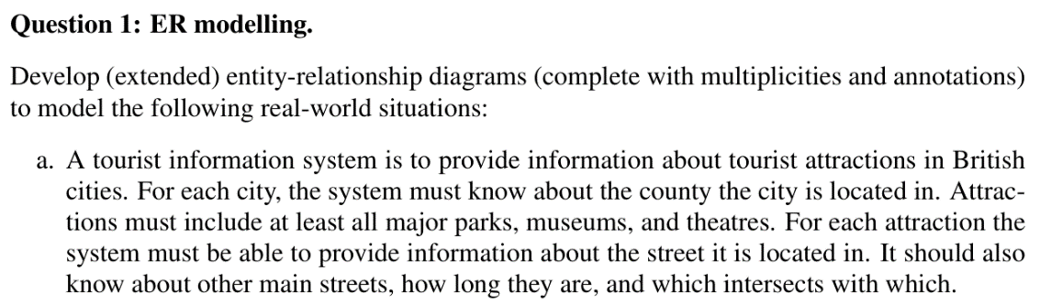

Slide 24
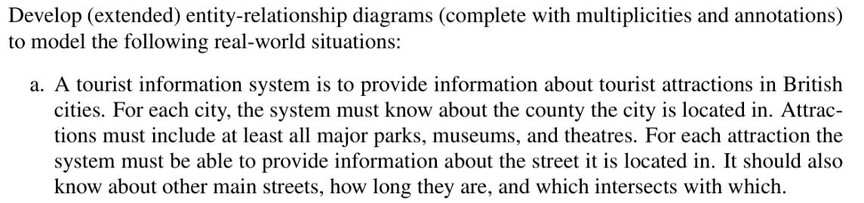
Identify Entities

Slide 25

Identify Relationship

Slide 27
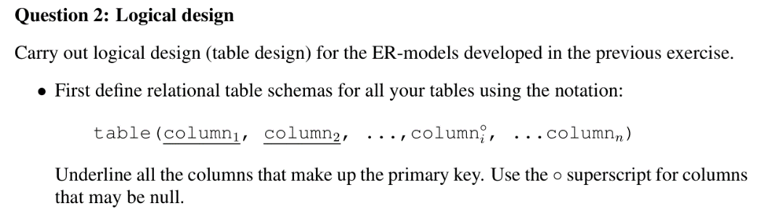

Slide 28
Outline (This Week)
(Part 0) SQL statements
ex00.pdf
PostgreSQL
(Part 1) ER modelling & Logical design
ex01.pdf
(Part 3) Relational algebra
ex02.pdf

Slide 29
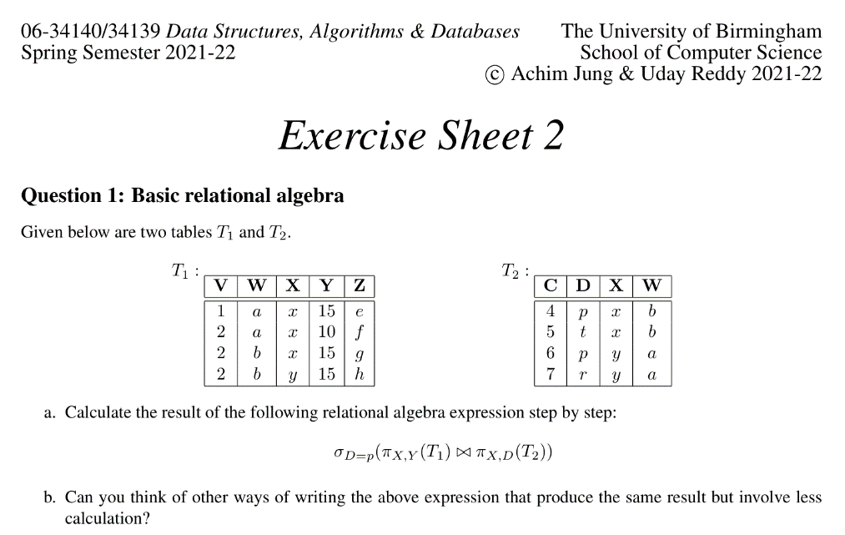

Slide 30
Fundamentals
Database

Slide 31
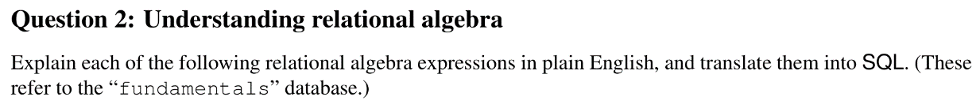

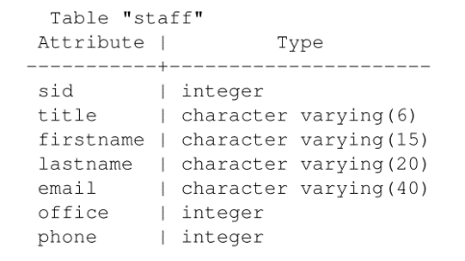
The last name of all those members of staff whose first name is ‘John’.

Slide 32
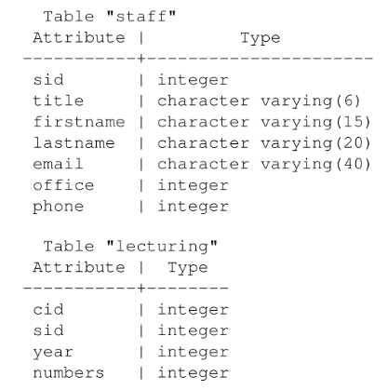

The family name of all those members of staff who taught a course with more than 100 students (in any year).

Slide 33
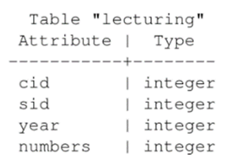
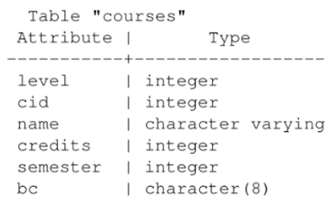
The name of those courses, which had more than 100 students on them in at least one year, and which are not at level 1.

Slide 34

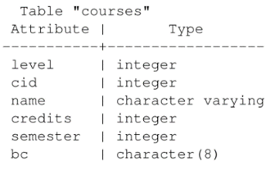
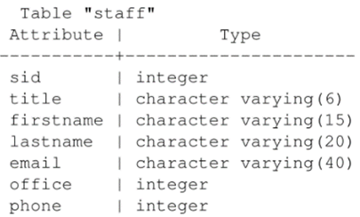
List members of staff with the level 2 courses they taught in 1999.

Slide 35
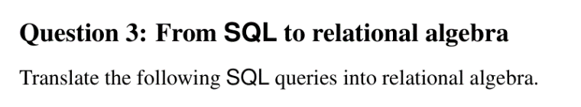
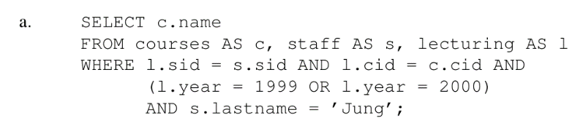

Slide 36
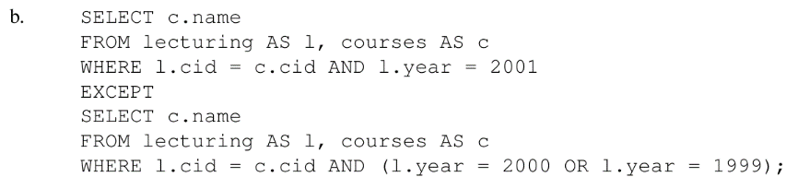

Slide 37
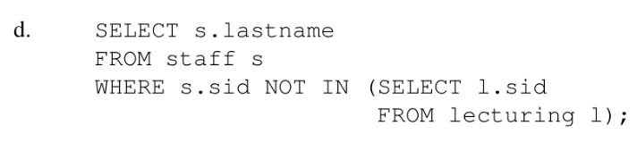

Slide 38
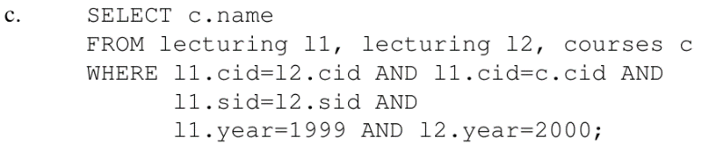


Slide 39
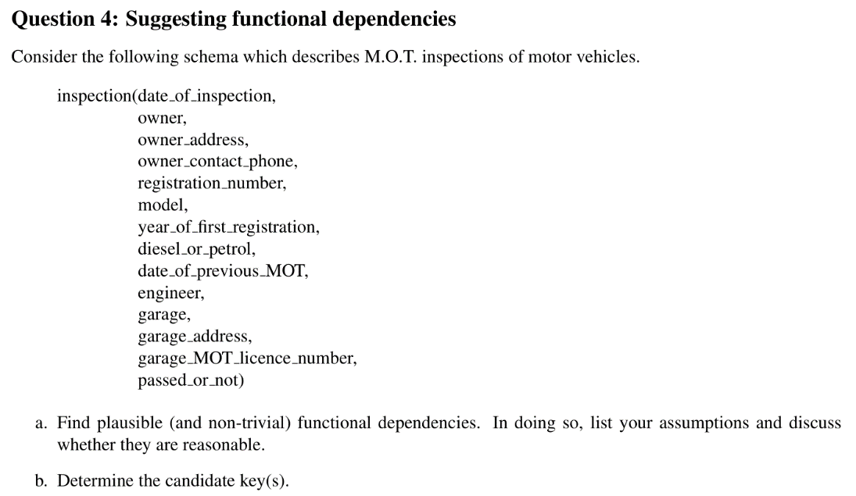

Slide 40
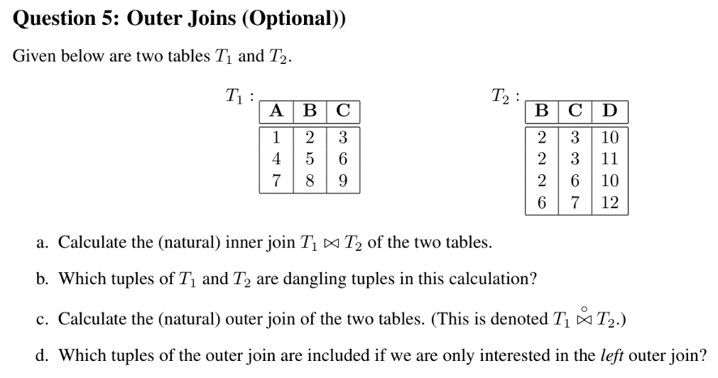

Slide 41
Questions?

